Slide 1
Chemical Warfare
Ritu Agarwal

Slide 2
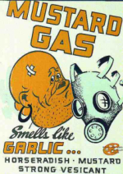
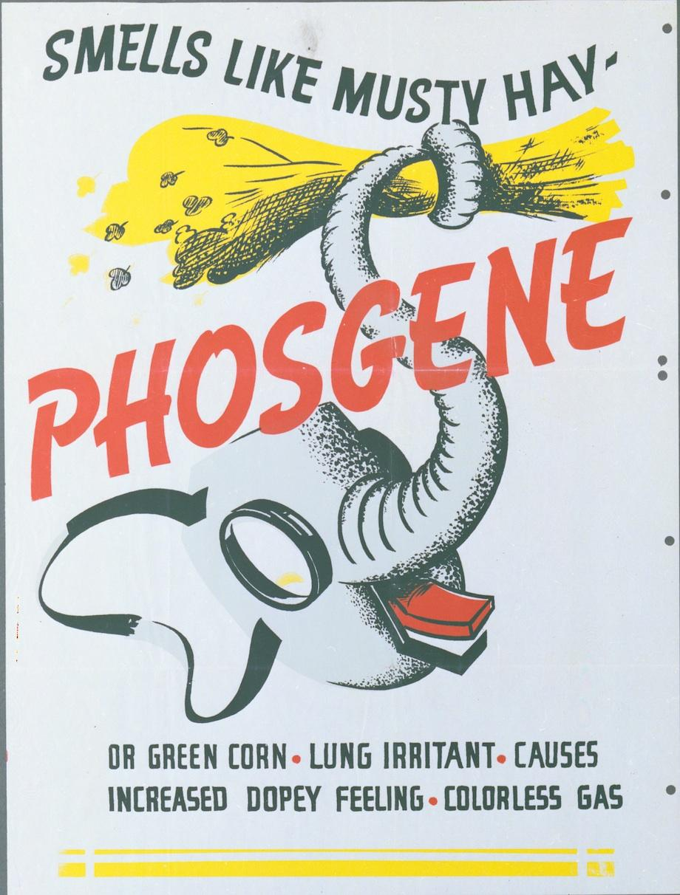
Introduction
First used during World War I
Sparingly used since then
Iran/Iraq used during war/subdue rebels
Many types
Nerve
Blister
choking

Slide 4
Chemical Weapon Deaths in WWI
Country | Non-Fatal | Deaths | Total
British Empire (Australia) | 180,597 | 8,109 | 188,706
France | 182,000 | 8,000 | 190,000
United States | 71,345 | 1,462 | 72,807
Italy | 55,373 | 4,627 | 60,000
Russia | 419,340 | 56,000 | 475,340
Germany | 191,000 | 9,000 | 200,000
Austria-Hungary | 97,000 | 3,000 | 100,000
Others | 9,000 | 1,000 | 10,000
Total | 1,205,655 | 94,148 | 1,296,853

Slide 9
Why I chose this issue
Model UN brought issue to forefront
Chlorine gas still allowed worldwide
Pressing threat to global security
Easily contaminate broad areas
Deadly past uses

Slide 10
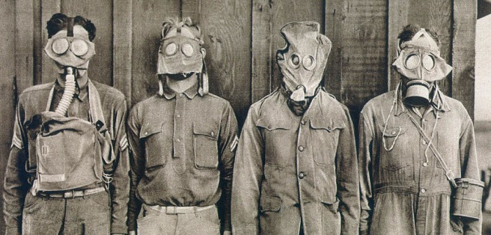
Why is it important?
World in turmoil
Technology already created and used in past
Capacity to kill in large scale
Currently used in Syria
Sarin
Chlorine Gas

Slide 11
What can be done to help this issue?
Write letters to Congress to work with UN and ban chlorine gas
Donate money to people in Syria
attacked by their government

Slide 12
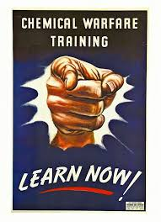
How I will help
Help create awareness
Support refugees from Syria
Donate medical supplies to help victims

Slide 13
Conclusion
Chemical weapons very dangerous
Hard to avoid contamination if in the area
Hard to treat affects of certain gases
Used in places of turmoil such as Syria
Future use must be prevented

